Slide 1
“Fluid-Structure modeling of a contracting atrium”
Jean Bragard¹, A. Quiriny², J. Lambrechts², B. Echebarria³, N. Moës², J-F. Remacle²
Department of Physics and Applied Mathematics, University of Navarra, Pamplona (ES)
iMMC, UCLouvain, Louvain-La-Neuve, Belgium.
Dept. Physics. Polytechnic University of Catalunya, Spain.
https://jeanbragard.github.io/
CMBBE, BCN, 3rd September 2025
Notes:
This is a research project that i have been doing this last semester while in a sabbatical at UCLouvain in Belgium.
The main objective of the project is to include the 3 principal aspects of the cardiac dynamics.
The electricity, the mechanics (solid) and fluid mechanics.
This is highly ambitious, and obvious simplifications have been made during the project.
I will briefly discuss those during this talk.

Slide 2
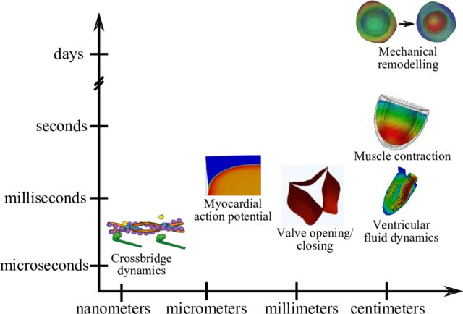
The heart is a multiphysics and multiscale system
“Integrated Heart - Coupling multiscale and multiphysics models for the simulation of the cardiac function”
A. Quarteroni, et al. , May 2016. Computer Methods in Applied Mechanics and Engineering 314
Notes:
From an engineering perspective, the heart is a very complex system.
We experience a wide variety of dynamics at various spatial and temporal scales.
From intracellular phenomena such as the reaction between actin and myosin filaments (nanometers and microseconds)
to generate the mechanical contraction of the cardiomyocyte.
To the changes in the heart in days or more (for example, during an athlete's training).
In addition to many interesting fluid problems, particularly associated with the opening and closing of the ventricular valves.

Slide 3
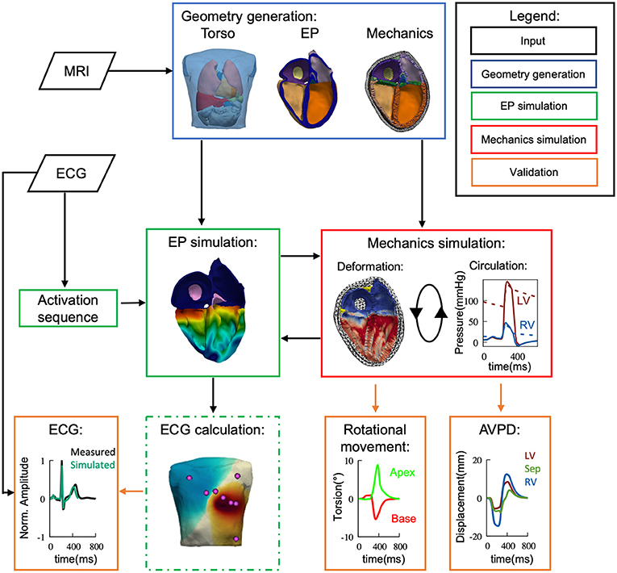
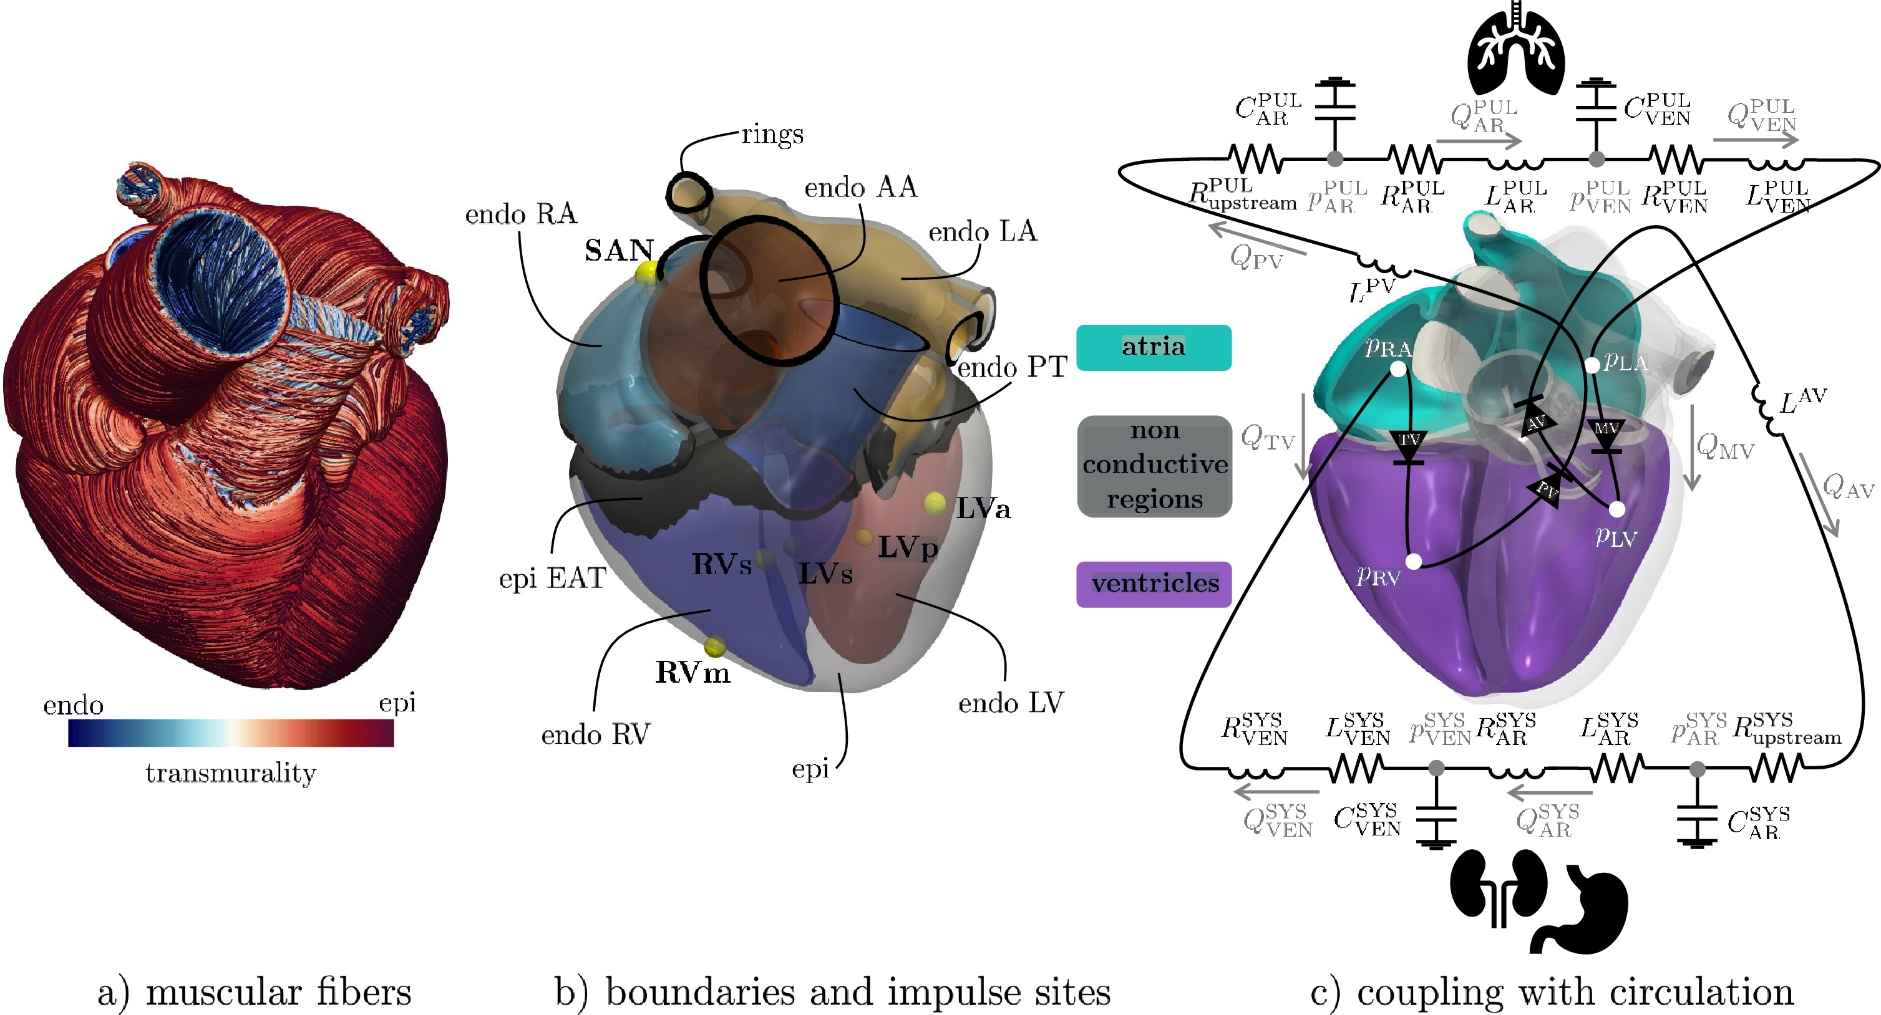

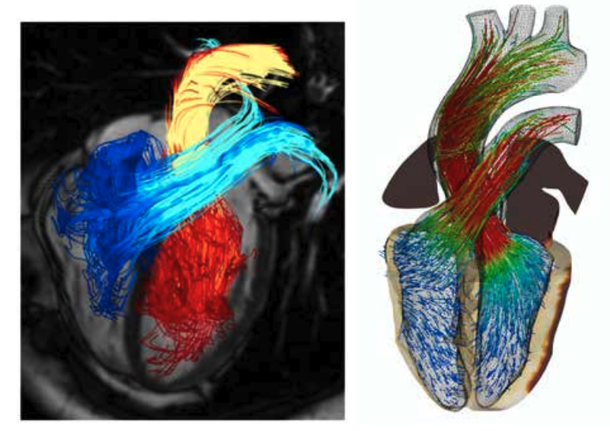
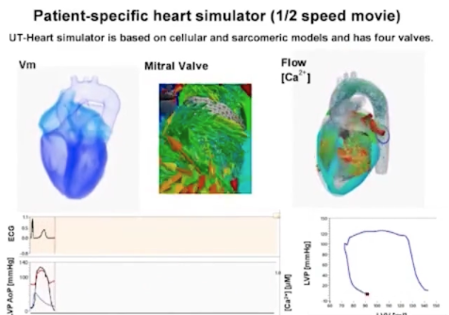
Few ”full” computational models of the heart (“digital twin”)
Polytec. Milano // EPFL (2023-2024)
A. Quarteroni
---> KIT //
U. Freiburg (2021)
https://doi.org/10.3389/fphys.2021.778872
https://doi.org/10.3390/math9111247
https://doi.org/10.1016/j.cma.2023.115983
https://doi.org/10.1016/j.jcp.2024.112885
Dassault System
Simulia // INRIA
FDA
<-BSC, Alya,
(Barcelona)
2018-2024
U. Tokyo (heart)
2012-
10.1002/cnm.3140
DOI:10.1016/j.jcp.2024.112885
DOI: 10.1007/978-1-0716-1831-8_10
https://ut-heart.com/
Towards personalized medicine...
Notes:
At the present times, only few groups in the world have developed full mathematical models
that include the 3 important aspects part of the heart function: Electrical, Contraction and fluid mechanics.
Here I have gathered the most well-known (Tokyo,INRIA,KIT,BSC, Polytech.Milano,..).
I beg your perdon if I miss yours.

Slide 4
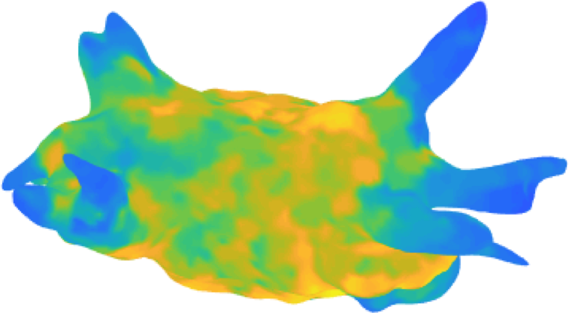
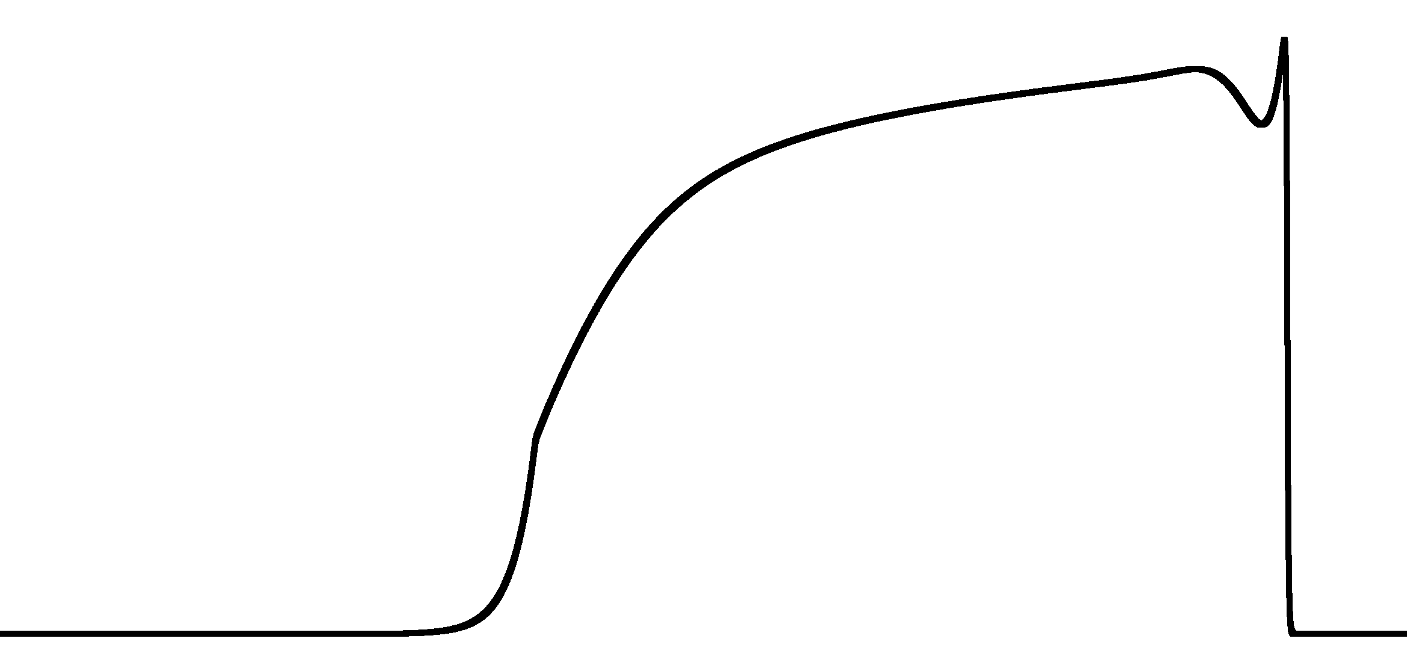
Aim: “simple-full model” of the left atrium
Simplify the geometry and include the full dynamics :
IN
Fluid inlet : 4 Pulmonary veins (O2 blood)
Electro.
p=p(t)
AP
Vm(t); Ca(t)
Fluid (Newtonian)
r(t)
Large displacement
Mecha.
Fluid outlet : Mitral valve (towards LV)
OUT
Why? Atrial Fibrillation is the most frequent cardiac disease and is generally located in the left atrium (main motivation).
Notes:
As i mentioned in the introduction, during my sabbatical semester in Louvain,
I planned to develop a simple model that would include all the three important ingredients.
(Electrical, mechanics, and fluid motion)
Full geometry would have been too much then i first stick to a simpler geometry.

Slide 5
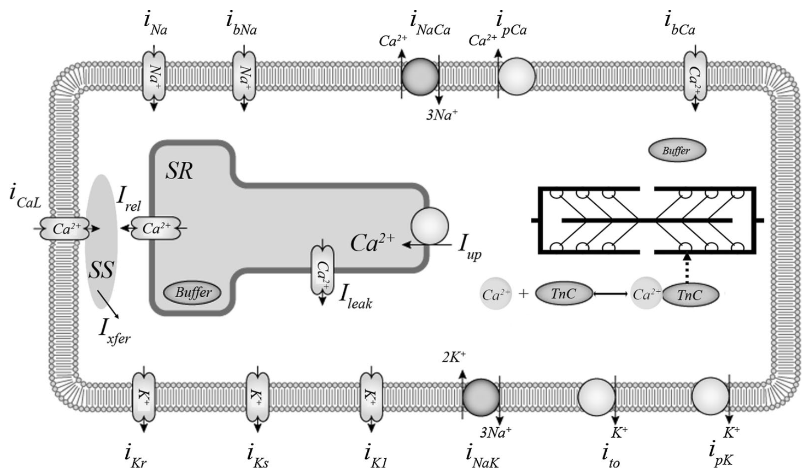
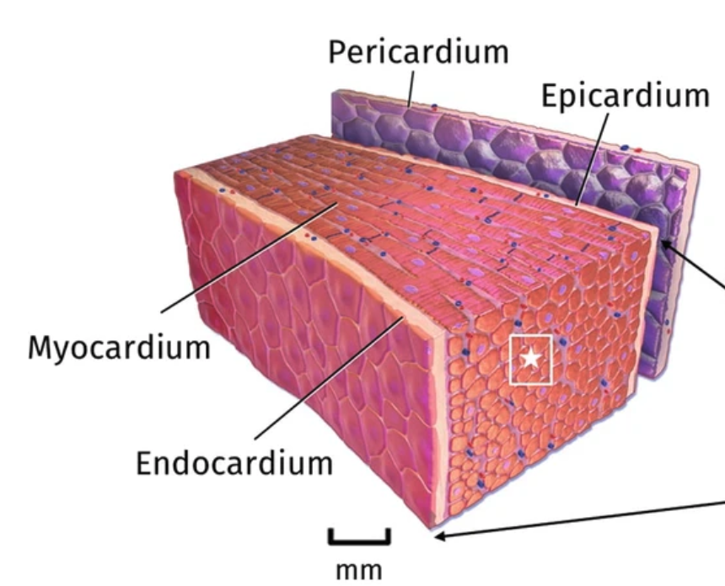
I) Modeling the electric part
I) The electric part (i.e., the action potential propagation through the tissue is the trigger for the mechanical contraction)
Cardiomyocyte (with intra-cellular Ca handling
+ Contractile element)
Equivalent Electric circuit
(Cell membrane)
Cardiac tissue as a continuous medium
Atrial Fibrillation is often due to electric malfunction of the cardiac tissue.
Notes:
There is a private joke that is circulating between the cardiac modelling community.
Basically it goes like the world of cardiac modellers is divided between electricians and plumbers !
I particular, I have been an electrician all my life and i had the ambition to be also a bit of a plumber !
But let’s start with what i know best !
The electricity is generated by the flow of ions through the cell membrane.
It generates an increase in Calcium ions inside the cell that lead to a biochemcial reaction btw the action and myosin that
generate an active mechanical stress inside the cardio-myocite.

Slide 6
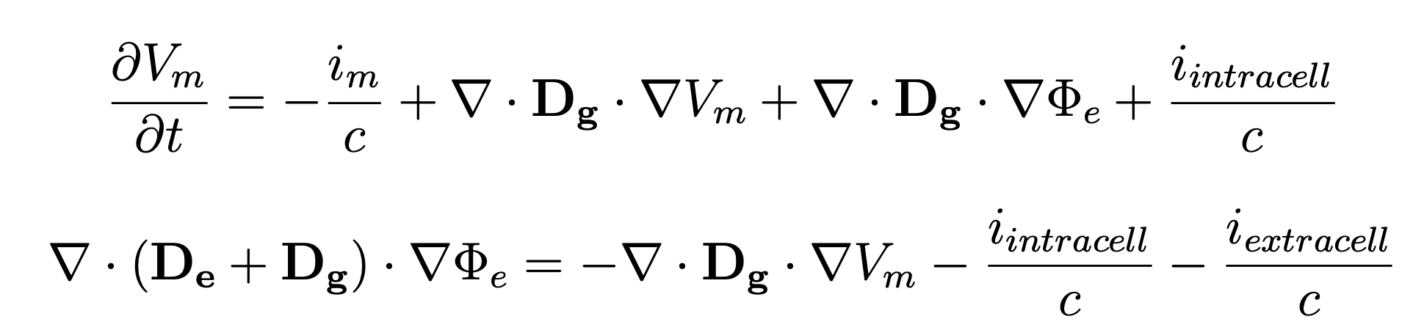
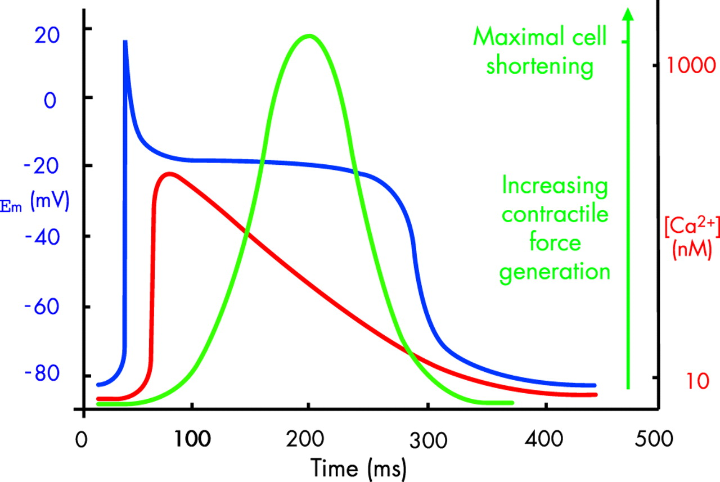
Ib) Technical part for the electric equations
I) We treat the cardiac tissue as a continuum. The PDEs for the membrane voltage are given by:
is the membrane potential (mV)
is the electrical diffusivity (cm²/ms)
Calcium pulse is slaved to AP pulse
Calcium triggers the contractile force.
“second messenger”
is the electrical conductivity (mS/cm)
Notes:
The descriptions of the dynamics of the electrical activity, which is basically the action potential waves that
are propagating in the cardiac tissue is described by the monodomain or bidomain equations.
There are PDE the permit to solve for the membrane potential as a function of space and time.

Slide 7
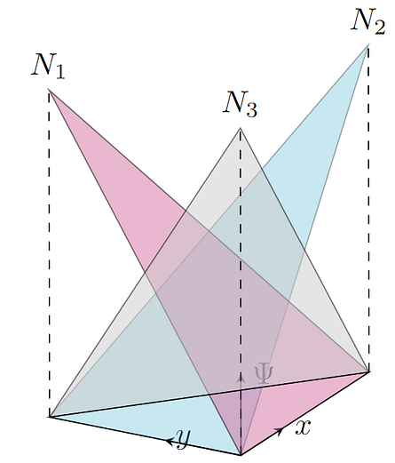
Dynamics: From local to weak form formulation (Galerkin)
this is difficult to deal with
in complex geometry
Strong form :
(Monodomain)
where u is a test function that
satisfies the essential BC.
Weak form :
u is the sum of the contribution
for each small element (all the triangles of the mesh)
On each element we interpolate the field
with the shape functions N₁, N₂ , N₃ , and
the unknown nodal values.
(Linear elements, P1).
Notes:
In general, these PDEs are solved on complicated geometries and therefore the method of choice for solving them is
the FEM.
In one slide, one can summarize the method as a “passage” from the “strong” to the “weak” (or variational form)
of the equation. Caveats (weak does not mean bad ! it is actually very good for finding the numerical solution.

Slide 8
Assembly: From weak formulation to “big” matrix equation.
This integral is true for any test function (u).
We use N test functions to get N equations.
Each test function satisfies
the essential BC.
Weak form :
i=1,...,Nv
Matrix form :
The source term (RHS) is usually nonlinear.
where vector V contains all the
nodal unknowns.
from the matrix element we can solve the “sparse” system, using, e.g.,
a Crank-Nicholson time stepping scheme.
Notes:
So after using valid test functiona nd some projection one get a large system of linear equation.
Note that the source term is in general nonlinear and some iterations maybe needed (implicit scheme).

Slide 9
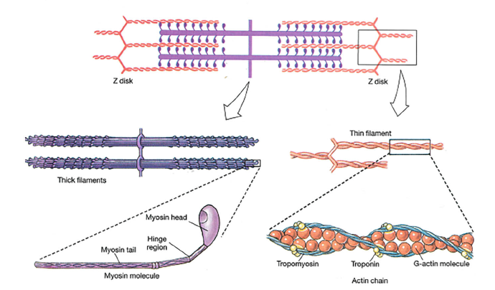
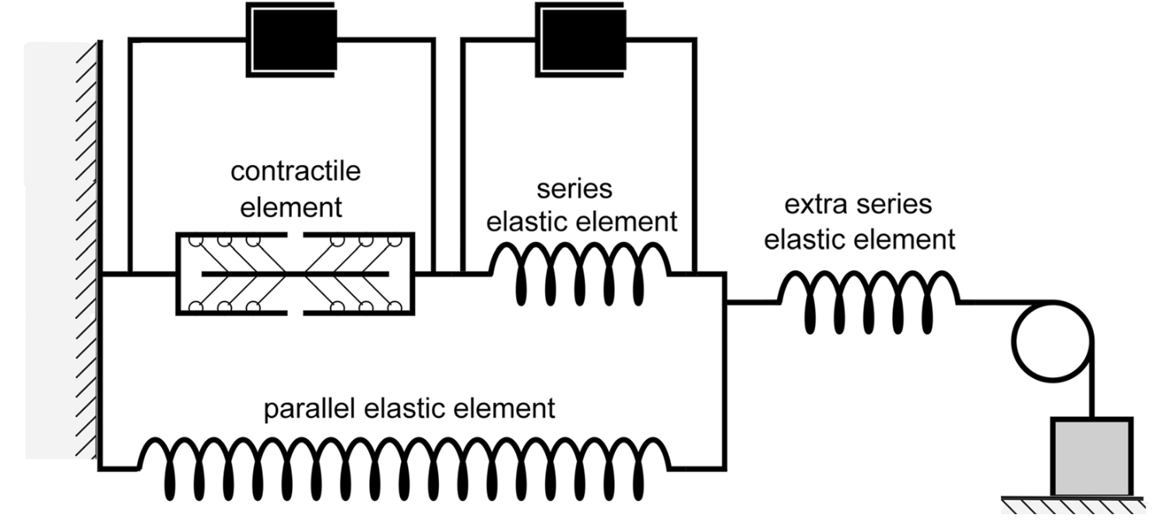
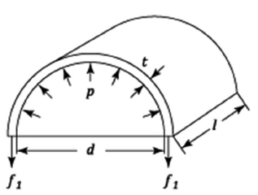
II) Modeling the mechanical part
I) The mechanical part contains an active “stress” source of biochemical origin.
Cardiomyocyte contains the contractile element
Active stress ( σ_{Act.} )
(Myosin heads pulling on actin fibers)
Equivalent mechanical
“microscopic” behavior
(Cell contraction+ tissue stiffness)
“Ekaterinburg-Oxford” model
Mechanical equilibrium for all time
+ inertia contributions
Notes:
In the introduction, i mentioned that the electricity induced an increase in calcium concentration that would in turn lead to
the generation of a mechanical stress inside the cell.
The cardiac tissue is highly complex from a material science point of view (this is certainly not a crystal or a simple steel alloys).
The constitutive equations are complicated and not definitely known (we have rheological models, Ogden, Holzapfel, Fung, ...).
A popular model nowadays is the Ekaterinburg-Oxford model that can be seen at the “microscopic” level as a combinations of springs
and dashpots together with an active contarctile elements.

Slide 10
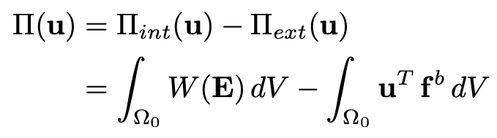
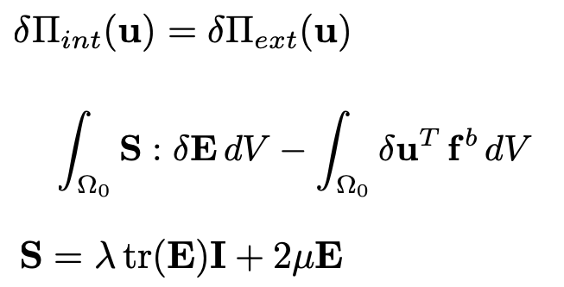
IIb) Technical part for mechanical equations
I) We treat the cardiac tissue as a continuum. We use again the weak form of the mecha. dynamics (PVD).
Potential energy:
At equilibrium, PVD says:
Weak form in the
reference configuration
Constitutive equation
St-Venant--Kirchhoff
From Cauchy (True) to Piola (Reference) !
Notes:
For the electricity, the kirchhoff laws (conservation of charges and energy) led to the governing PDE of the system.
For the mechanics we can start directly to the variational formulation of the mechanics through the “principle” of virtual displacement
that claims that at mechanical equilibrium the virtual internal and external energy are the same.
One caveats here, in mechanics one like to work in a Lagrangian framework and refer to the refrence (underformed) configuration.
Therefore one use for stress the second-piola kirchoff tensor for stress and the Euler-Lagrange strain tensor.
In my project i stick with a simple hyper-elastic constitutive equation given by the St venant-kirchoff law.

Slide 11
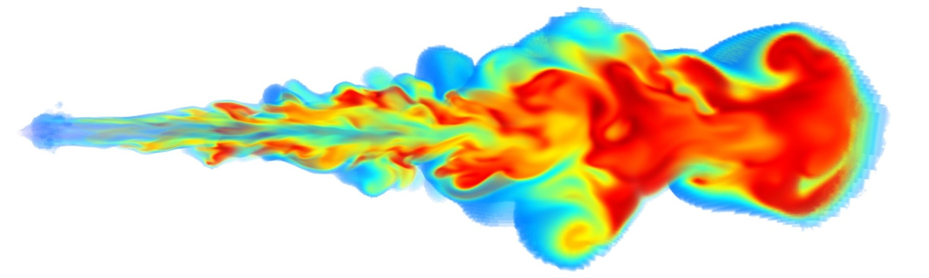
III) Modeling the fluid mechanical part
For the fluid mechanical part, we will use the “MIGFLOW” software developed at UCLouvain*
MIGFLOW was initially conceived to deal with the mixture of granular medium + fluid interactions.
Here we start using the “pure” fluid mechanical part of the software.
https://www.migflow.be/
Blood as a Newtonian fluid.
*Constant M., Dubois F., Lambrechts J. and Legat V. Implementation of an unresolved stabilised FEM–DEM model to solve immersed granular flows in Computational Particle Mechanics (2018). https://doi.org/10.1007/s40571-018-0209-4
Notes:
Now , we have to add the third part.
the fluid equations. here the governing equations are the Navier-Stokes equation (usually express in eulerian coordinates) +
the (mass conservation) incompresibility condition (div v =0).
here i took advantage of the MIGFLOW software that integrates the NS equations . Discrétisation is P1-P1 stabilisée (PSPG + SUPG) dans un framework ALE.
( the fluid volume can/will vary as a function of time)

Slide 12
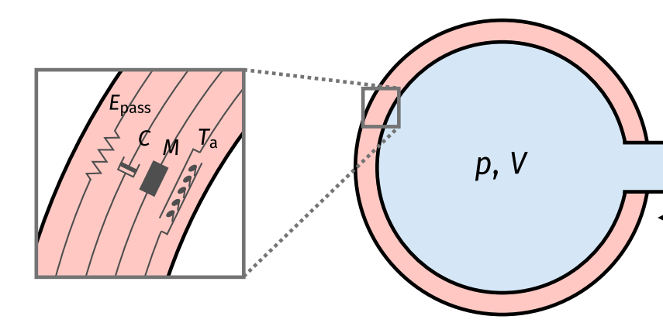
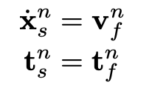
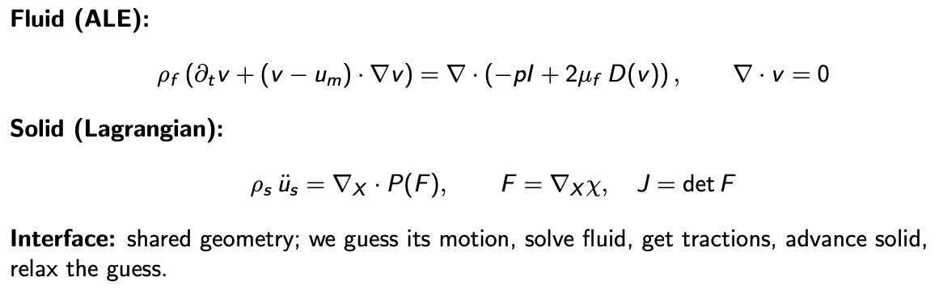
IV) Fluid-Structure Interaction
The fluid equations (NS) and the membrane dynamics must agree at the interface.
Move at the same speed (kinematic condition)
Share the same forces (dynamic condition)
We use a partitioned, strongly-coupled scheme with FSI sub-iterations and Aitken relaxation.
Notes:
The tricky part is to connect the solid and fluid mechanical part.
For the aeronautical engineers it’s a piece of cake !
but for a mere electrician it’s not trivial !
basically the solid interface moves in agreement with what happens in the fluid at the interface.
We have two conditions (kinematic and dynamics) that show that the interface motion is the same in
the fluid and in the solid . and that the forces they share are the same (3rd Newton law).

Slide 13
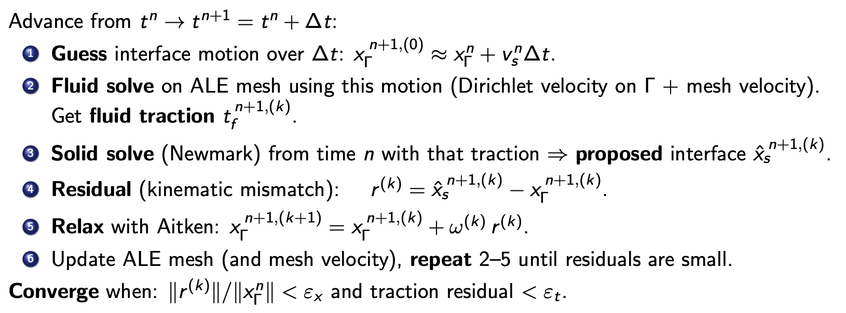
IVb) Technical part for FSI iterations
Notes:
Numerically, we used a partionned , strongly coupled-scheme to solve for the motion of the interface.
Here is the quick algorithm for the motion of the interface between t and t+delta t.

Slide 14
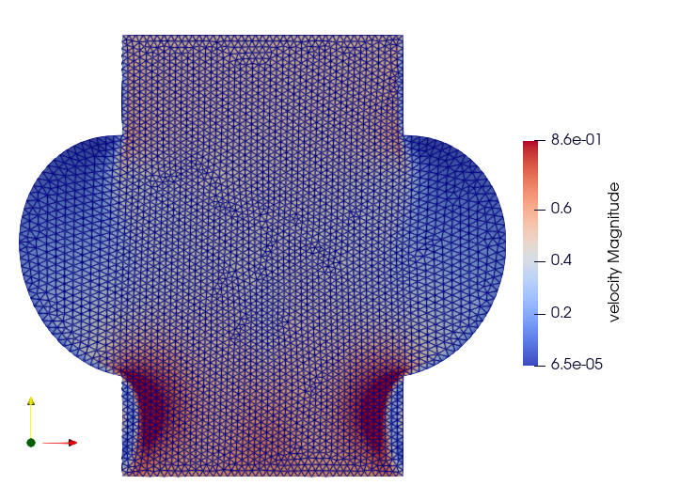
Geometry (2D) and Mesh (ALE)
Inlet (impose pressure, PV(t))
5cm
The boundary conditions at the
entrance and exit of the atrium are
given by the auxiliary simulation of
a general 0D circulation model.
Outlet (impose velocity, from Q__{MV}(t))
Notes:
Finally the cavity (or left atrium) is not living alone but inside of a more general circulatory system.
therefore one must impose sensible BCs to the inlet and outlet of this system.
In our case we solve previously a 0D circulatory system that we then connect to the 2D system.
Pressure is impose at the INLET (Pulmonary veins),
Velocity (from the MV flow) is imposed at the outlet.

Slide 15
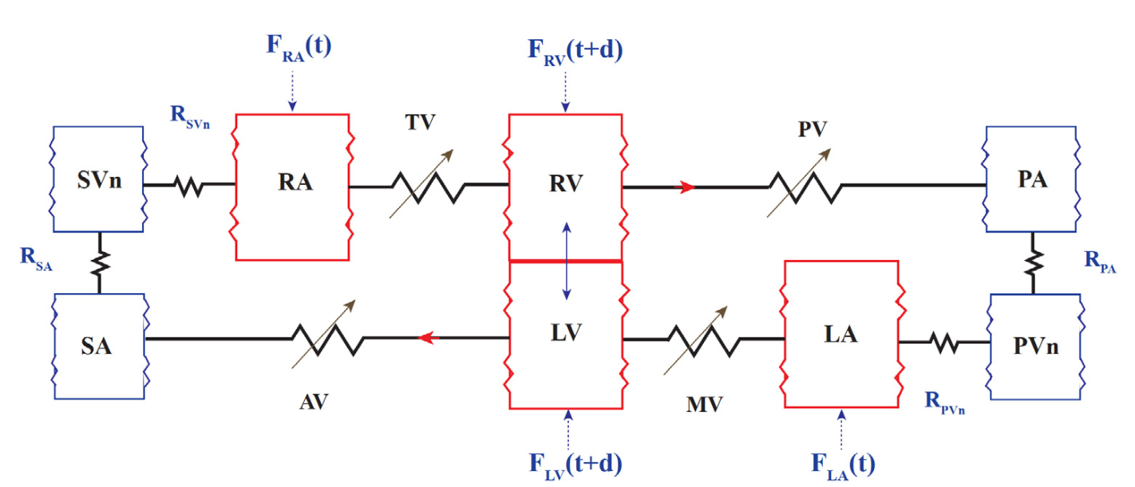
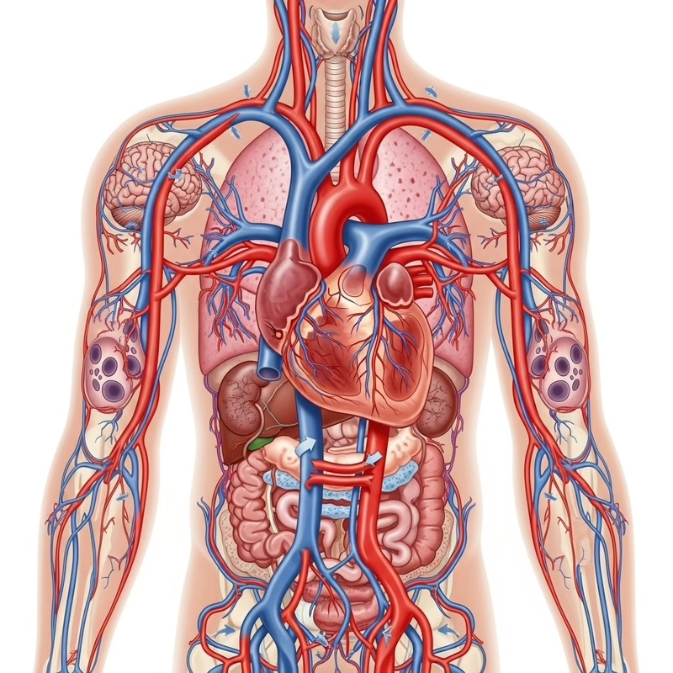
V) Connection with a 0D model of blood circulation
Study of the cardiovascular system (sheep)
subject to significant heart rhythm changes.
Novelties:
time-dependent muscle force
with constant elasticity
new model of the atria
inter-ventricular interaction
hysteresis in the aortic valve
parameters fitted from 14 sheep
y(t) = [V_la, V_sa, V_ra, V_pa, V_pv, P_la, P_ra, P_lv, P_rv] 9 variables to integrate
# left atrium pressure (5 parameters)
if dV_la < 0 :
dP_la = E_la * dV_la + dG_la + alpha_l * (V_la - V_unla)
else :
dP_la = beta_l * E_la * dV_la + gamma_l * dG_la + omega_l * (V_la - V_unla)
S. Noreen et al., “Mathematical modelling of atrial and ventricular pressure–volume dynamics and their change with heart rate”, Math. Bioscience 344 (2022). doi.org/10.1016/j.mbs.2021.108766
Notes:
The 0D circulatory system that we have chosen is the one recently published by Noreen et al.
they are (not as for the full 3d) many 0D models and this one is just a convenient one.

Slide 16
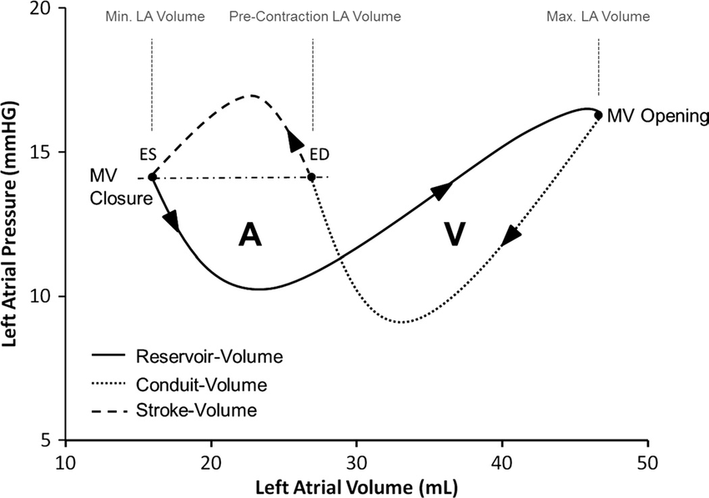
VI) Validation : P-V diagram for the Left Atrium
1. Mitral Valve (MV) Closure (~0.1 sec)
Occurs at the beginning of ventricular systole.
2. Atrial Relaxation & Reservoir Phase
(~0.1–0.5 sec)
The left atrium passively fills with blood
while the mitral valve is closed.
3. Conduit Phase (Early Diastole: ~0.5–0.7 sec)
The left atrium acts as a passive conduit,
transferring blood into the left ventricle.
4. Atrial Systole
(Booster Pump Function, ~0.7–0.8 sec)
The left atrium actively contracts to push
the remaining blood into the left ventricle.
0.8 s
0.5 s
0.7 s
0.1 s
Typical figure of eight !
Notes:
By integrating the 0D system, one gets very realistiv PV curves (for example in the left atrium)
that are characteristic of the work that is generated inside the atrium .
we got the typical figure of eight with the 3 distinct phases for the filling and emp`tying of the atrium.
Reservoir+Conduit+Atrial Kick

Slide 17
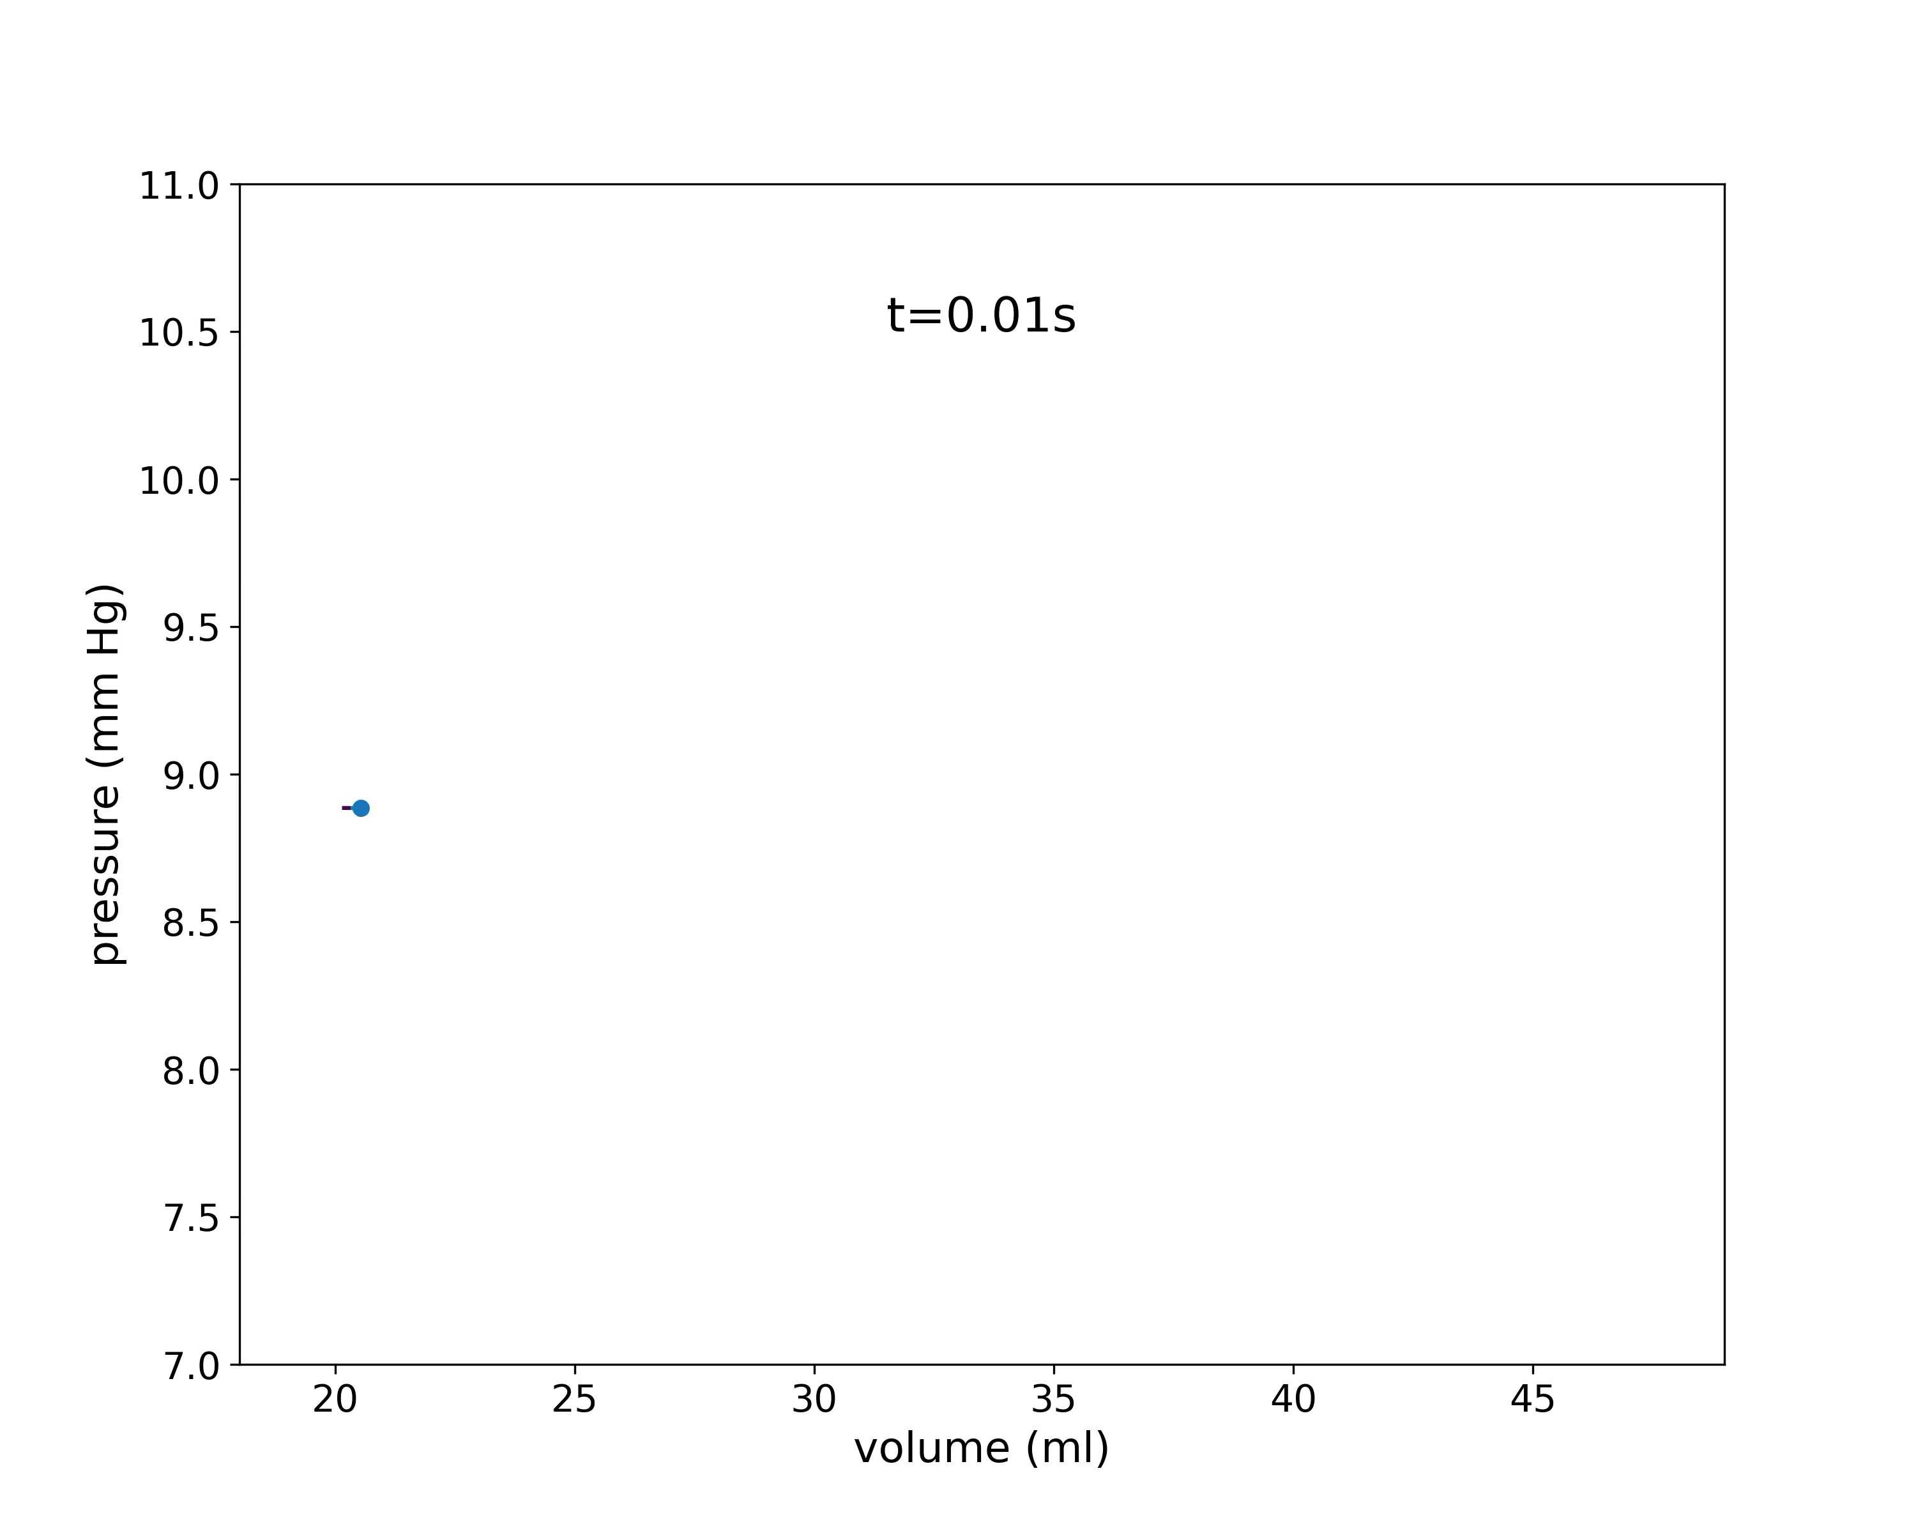
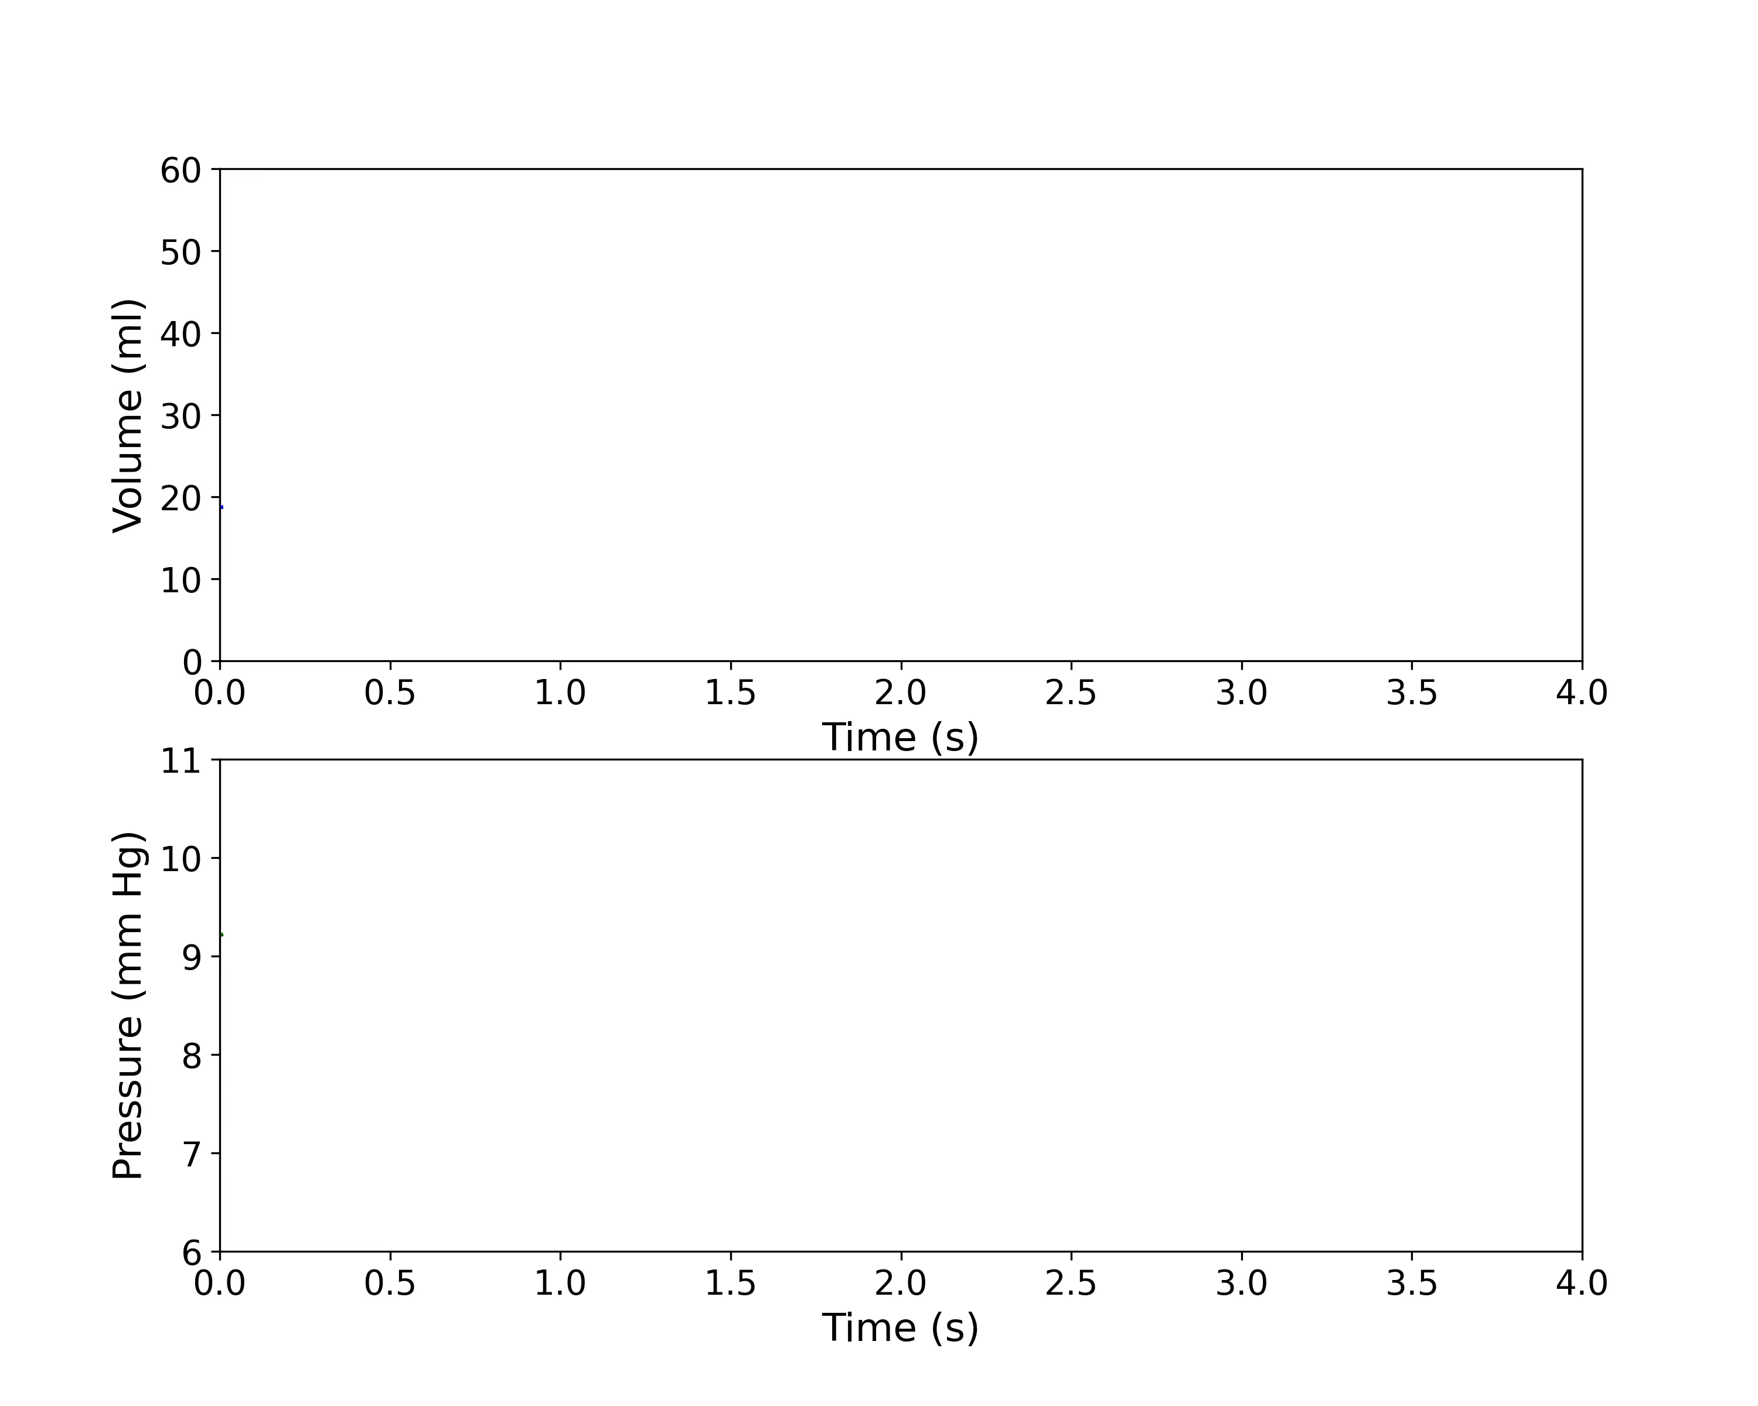

VIb) Results from the 2D model
PV loop
time traces
Velocity field
Notes:
From there we integrate the 2D model and where able to recover also this figure of eight...
even with a little bit of noise (vibrations), but less adjustable parameters (5 in the LA of the 0D model)...

Slide 18
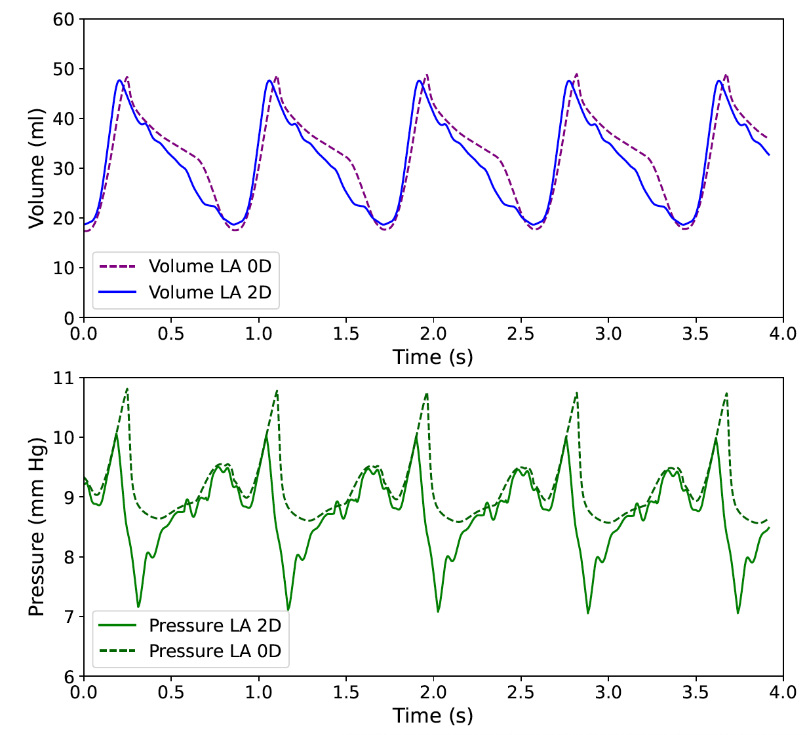
VIc) Comparisons btw 2D and 0D models
Notes:
The quantitative comparison of the time trace of the pressure and volume are satisfactory and it’s a good starting point
in the modelling of the 3 important aspects of the cardiac activity.

Slide 19
Conclusions and discussions
We have built a simple 2D model of the heart cavity (LA) that includes mechanics, fluid and active tension (electricity).
We use a 0D model to connect the 2D model to general circulation.
We got a reasonable quantitative agreement btw the 2D and 0D model.
FSI & BCs were the trickier parts to implement in the 2D model.
More realistic modeling (all aspects) will be proposed in the future.
Connections with experiments and medical issues are highly desirable.
Notes:
Here are the conclusions:
1) we have been able to built a 2d model that includes...

Slide 20

Acknowledgements
Special thanks to iMMC (UCLouvain) for kindly hosting this research project,
and to the Mobility Program of the Science and University Ministry (PRX23/294).
Also acknowledge the Financial support through grant
PID2023-152610OB-C22 funded by:
Financial support through ERC grant, ref. No. 101 071 255.
iMMC, UCLouvain

